Slide 1

WELCOME

Slide 2

Title
Stock Market Analysis

Slide 3
Group No. 6
Members:-
MS. AKSA SHAIKH
MS. DHANYA S
MR. MUTTU MANOJ KUMAR
MR. RAJEEV VARMA D
MR. SWAROOP H A
MR. MITESH R BEDRE

Slide 4
Summary
This real-time data project is designed to ensure data accuracy and reliability by using a combination of Excel, Tableau, MySQL, and Power BI.
We aim to provide actionable insights through continuous monitoring and key performance indicators (KPIs).
We used Excel for data pre-processing and validation, Tableau for interactive dashboards, MySQL for robust data storage, and Power BI for effective data visualization.
Through these tools, we try to identify the key findings and KPIs critical in assessing data correctness, helping us maintain data accuracy and make more informed decisions.

Slide 5
KPI List
Average Daily Trading Volume
Most Volatile Stocks
Stocks with Highest Dividend and Lowest Dividend
Highest and Lowest P/E Ratios
Stocks with Highest Market Cap
Stocks with Strong Buy Signals and stocks with Strong Selling Signal

Slide 6
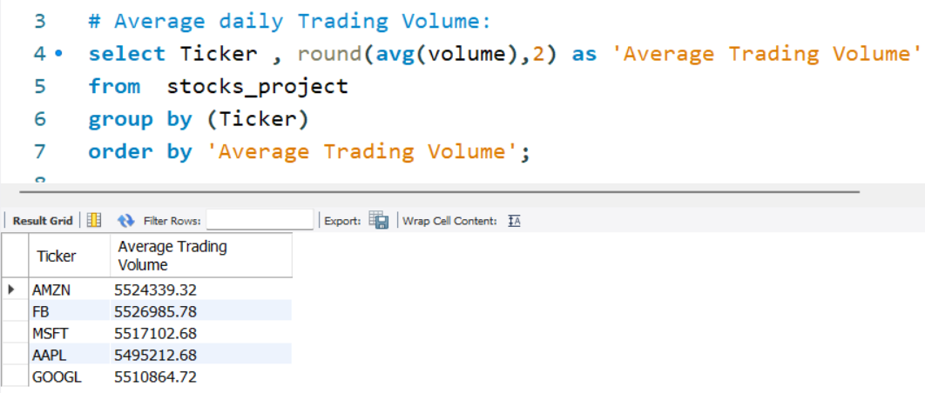
KPI. 1
Average Daily Trading Volume:-
The average number of shares traded daily
High Trading volume indicates that a stock market is highly liquid

Slide 7
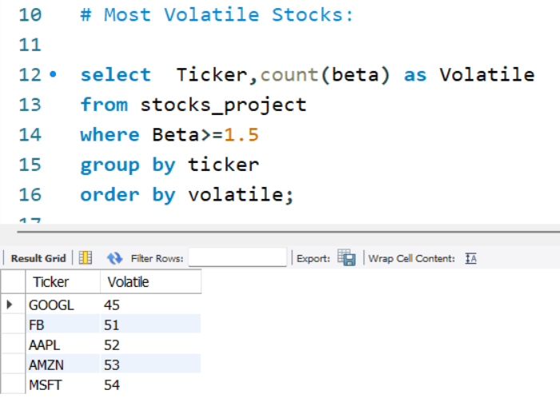
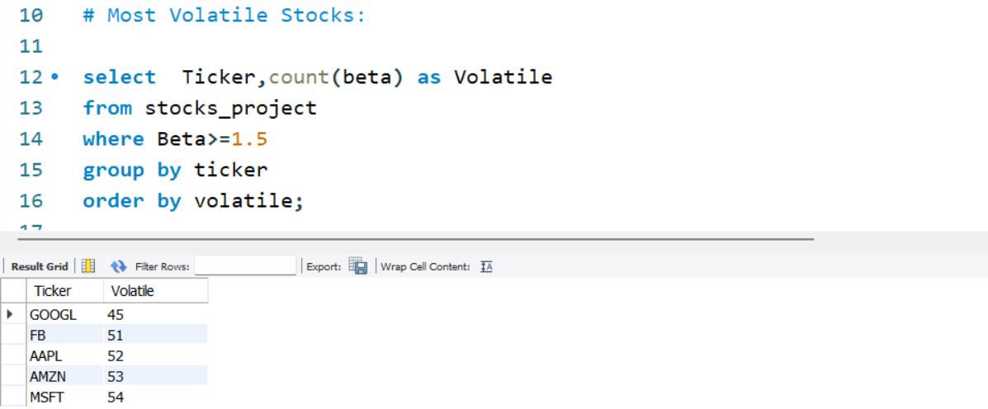
KPI. 2
Most Volatile Stocks:-
Stocks with the highest Beta values
Indicate that they are more volatile and have higher price sensitivity to market movements

Slide 8
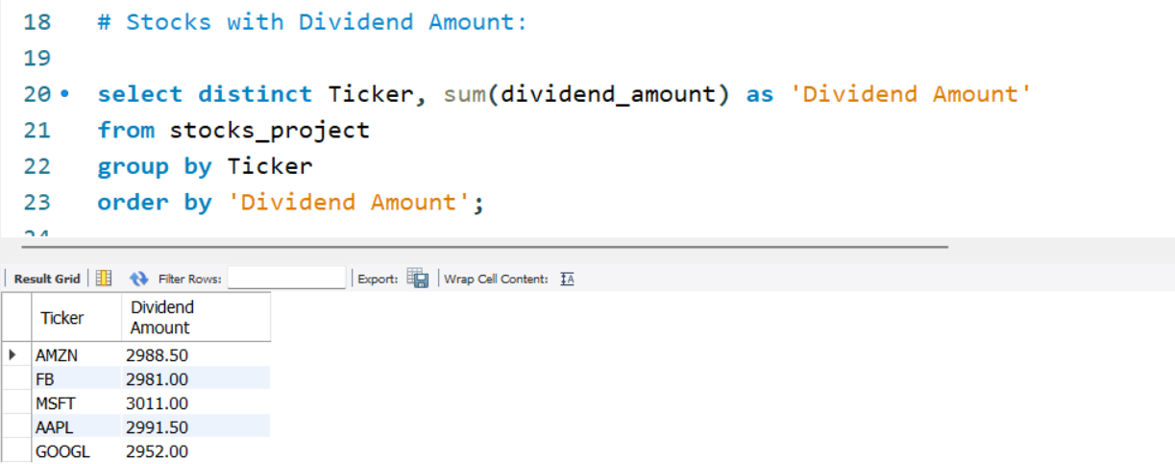
KPI. 3
Stocks with Highest Dividend and Lowest Dividend:-
Stocks that have provided the highest dividend amounts and lowest amounts
Stocks with low or no dividends are often associated with growth investing

Slide 9
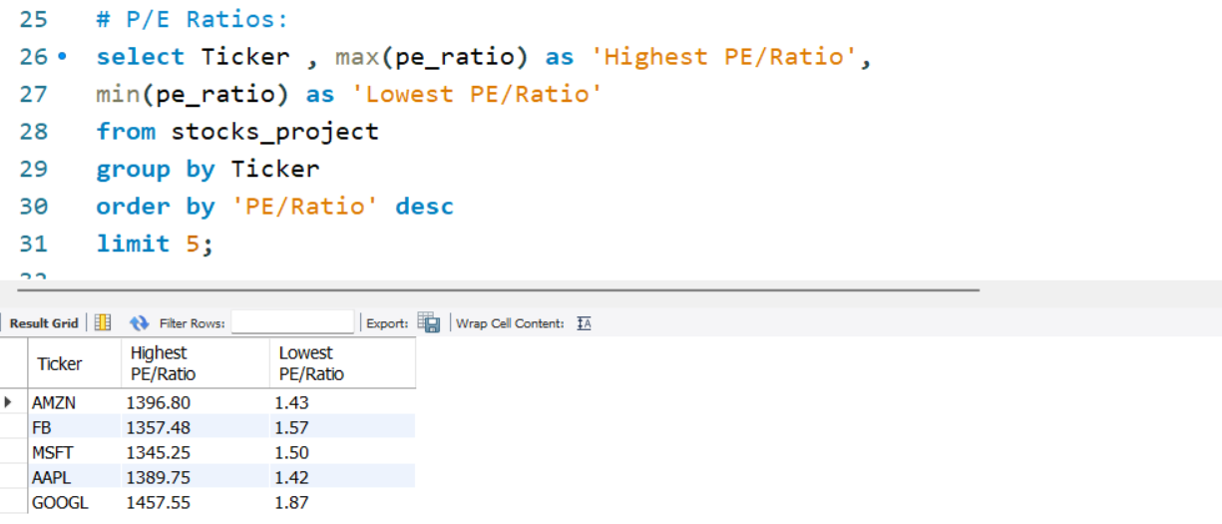
KPI. 4
Highest and Lowest P/E Ratios:-
Identification of stocks with the highest and lowest Price-to-Earnings ratios
High P/E ratios are often associated with stocks that investors expect to have strong earning growth in the future.
Low P/E ratios are often associated with value stocks

Slide 10
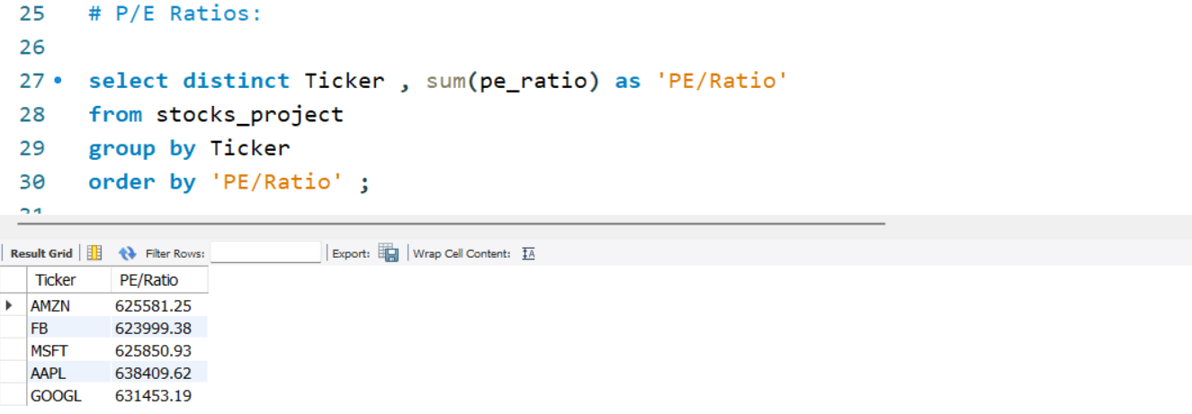
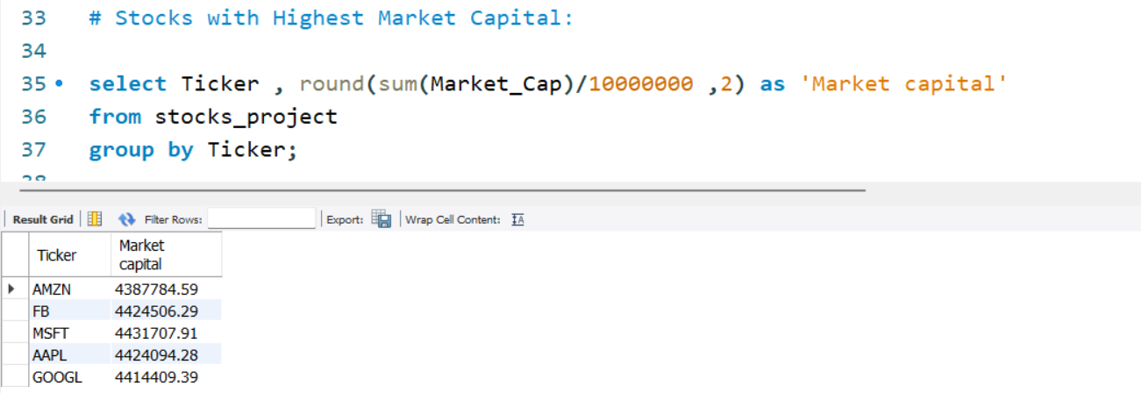
KPI. 5
Stocks with Highest Market Cap:-
Companies with the largest market capitalizations
Stocks with the highest market cap offer stability and liquidity, they may not offer the same growth opportunities as smaller, high growth stocks

Slide 11
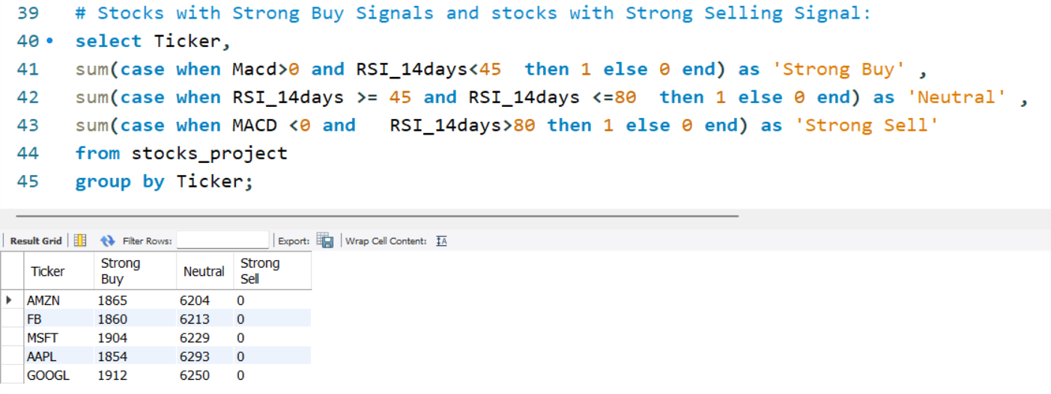
KPI. 6
Stocks with Strong Buy Signals and stocks with Strong Selling Signal:-
RSI below 45 indicates oversold market and a sign of potential buying opportunity
RSI value is between 45 and 80 is often considered as a neutral zone, suggesting the stability in the price movements
RSI value is greater than 80 indicates overbought condition and a sign of potentially strong selling opportunity.
MACD value is greater than 0, it means that the stock’s short-term trend is bullish
This can be seen as a potential buying signal and when the MACD value is less than 0 indicates that stock short term trend is bearish

Slide 12

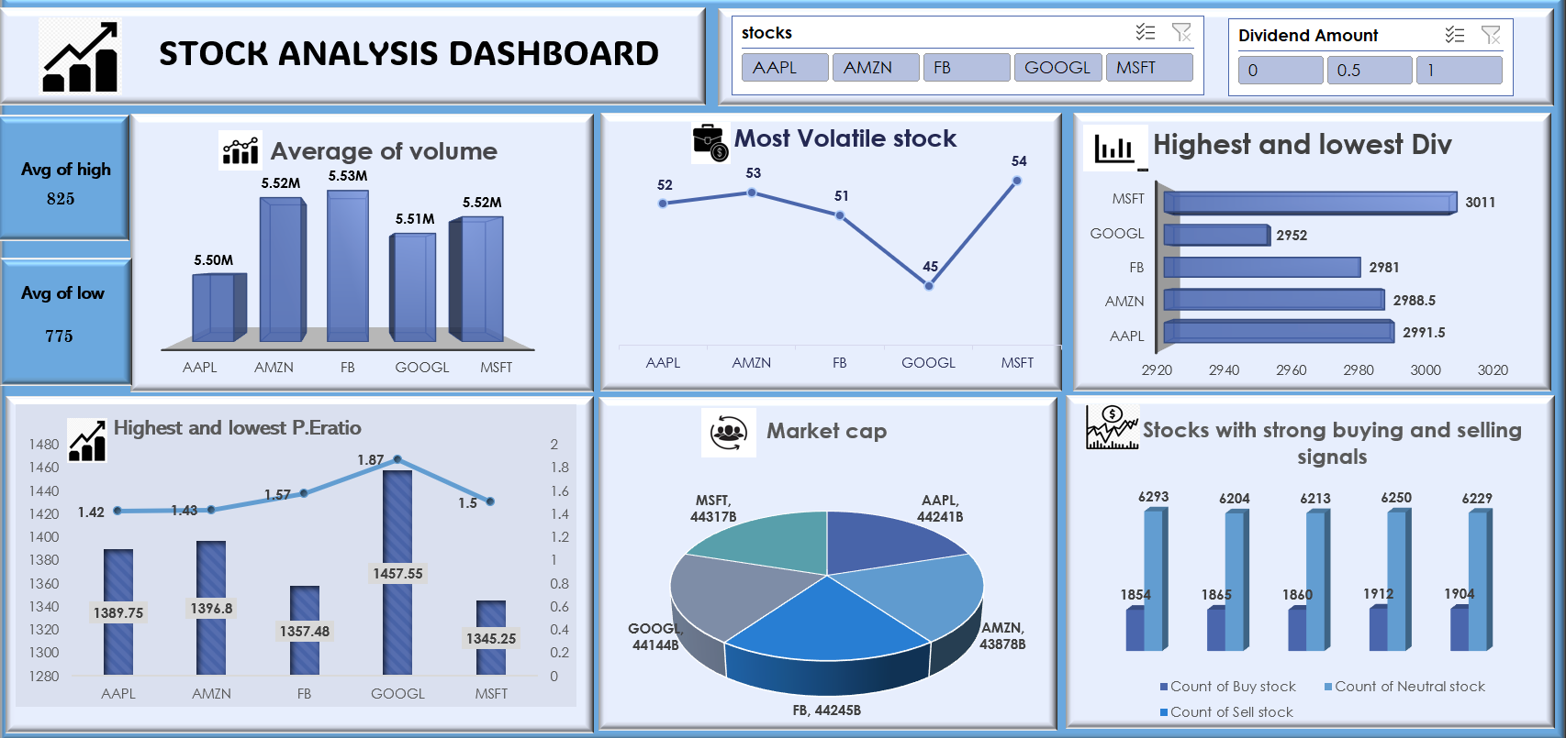

EXCEL

Slide 13

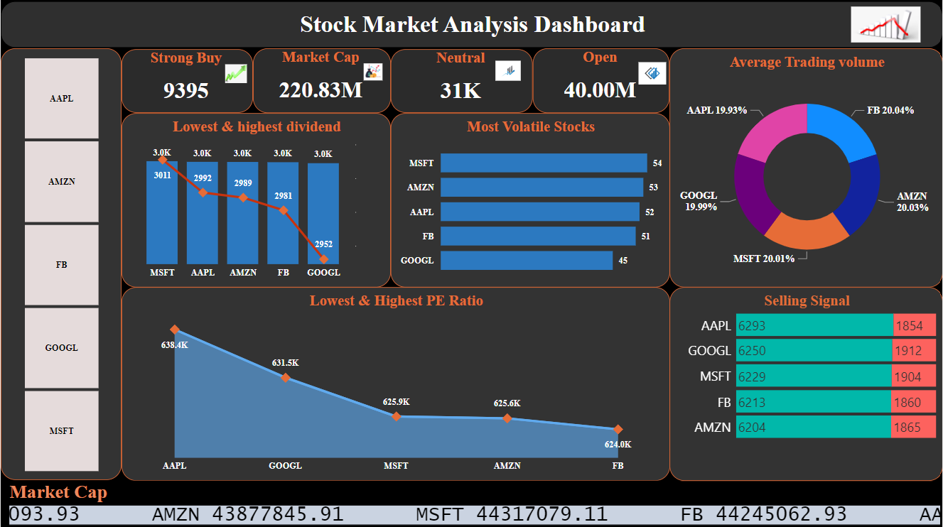
Power Bi

Slide 14

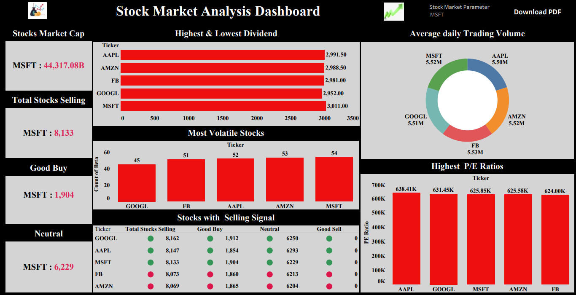
Tableau

Slide 15
Conclusion
The analysis of the dataset provides valuable insights into the stock market performance of selected major companies.
These insights can aid investors and financial analysts in making informed decisions regarding stock purchases, sales, or holdings.
Provided analytical support , maintaining database and conducting analysis as required.
Worked on the development of Dashboards in order to stabilize the stocks and maximize the values.
This analysis provided valuable insights of the company’s financial performance.

Slide 16


